Slide 1
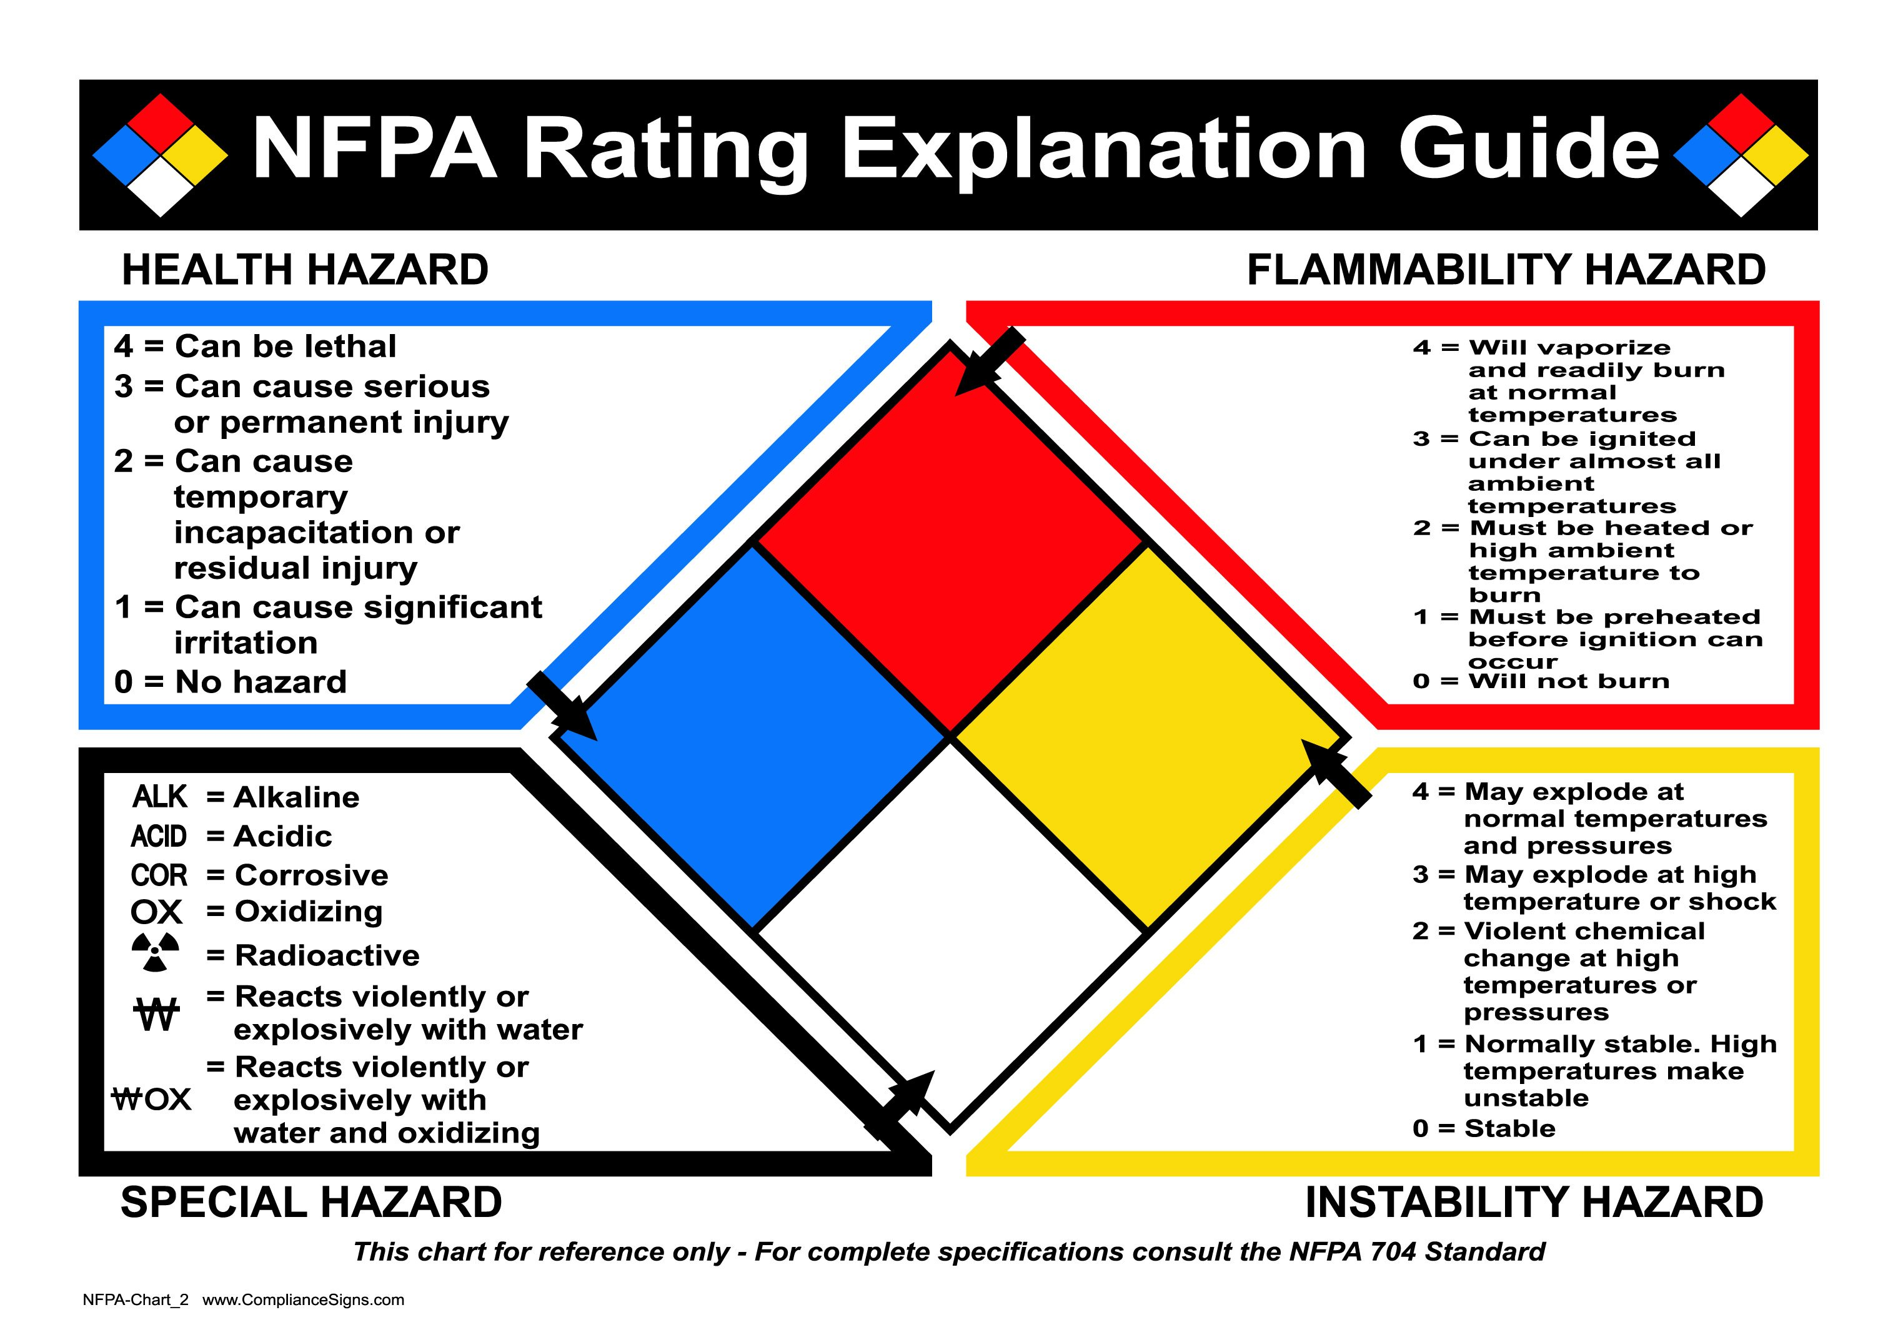
NFPA 704：a simple, readily recognized system used for identifying the hazards of materials and the severity of those hazards.
Notes:
Each of health, flammability and reactivity is rated on a scale from 0 (no hazard) to 4 (severe risk).
820 C 5 min, 93 C, NH3 37.8-93.3 C,
Very short exposure could cause death or major residual injury
The white “special notice” area can contain several symbols.

