Slide 1
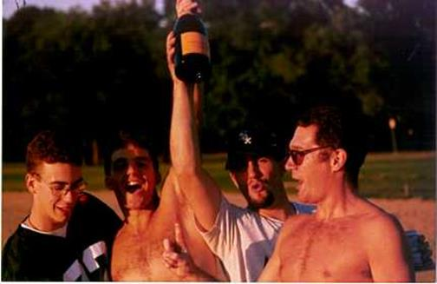
Tanner Jankins LongLit March 5, 2019
The Life Works of Gregory Hillhouse

Slide 2
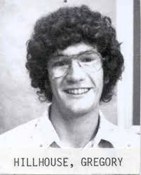

Gregory Hillhouse
Education and Career
1976 B. S. in Chemistry, University of South Carolina
1980 Ph. D., Indiana University, (Barry Haymore) "Reactions of Tungsten Complexes with Molecules containing Nitrogen-Nitrogen Bonds”
1983 Postdoc, Caltech, (John Bercaw)
1983 Professor at University of Chicago
2005 Visiting Professor at MIT
Awards and Prizes
1989 Alfred P. Sloan Prize
1997 Quantrell award for Undergradutate Teaching
2012 Dow Lecture in Inorganic Chemistry
2013 ACS award for Organometallic Chemistry
Outside of Lab
2012 Guest Chef in Charlie Trotter’s
1990s Intramural Basketball All-Star
1990-2002 UC 6x softball champions
*This does not cover every work due to time constraints. Works covered don’t reflect the most “important” works, but one that fit with the theme of this presentation. Also Scirpps does not have access to Polyhedron, so these papers could not be accessed.

Slide 3
Overview
1. Supervised Work
2. Early Career
3. Double Nickel and Related Species

Slide 4
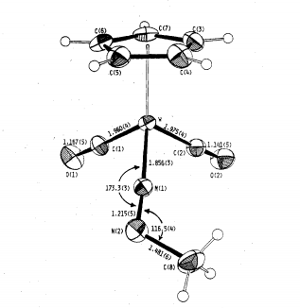
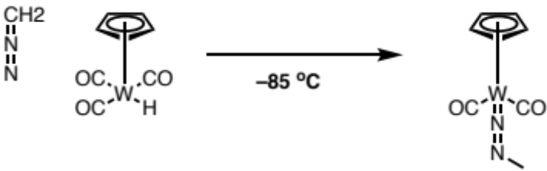
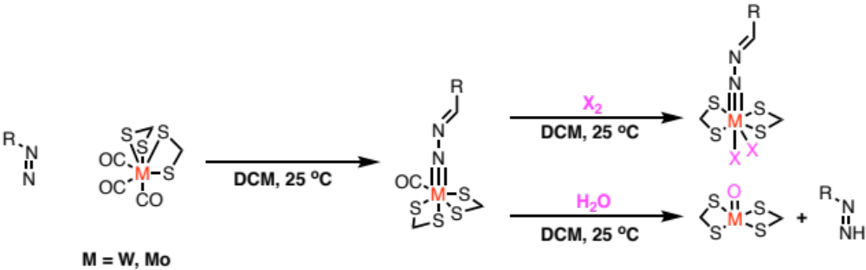
Graduate Work
Synthesis of alkyldiazo tungsten complex
Inorg. Chem. 1979, 18, 2423−2426
Synthesis and reactivity of alkyldiazo group VI metals
J. Am. Chem. Soc. 1982, 104, 1537−1548.

Slide 5
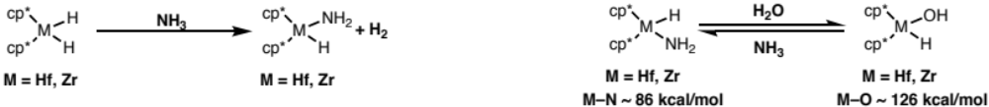
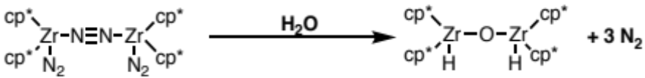
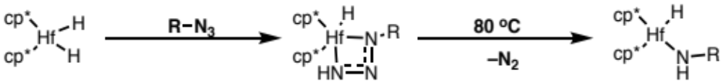
Postdoc
Reactivity of group IV cp* complexes with water
Reactivity of group IV cp* complexes with ammonia
4e reduction of water
J. Am. Chem. Soc., 1984, 106, 5472–5478
Synthesis of Hf azido complexes
Organometallics 1982,1, 1025-1029

Slide 6
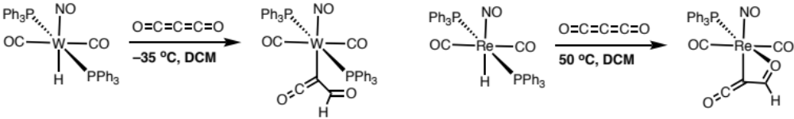
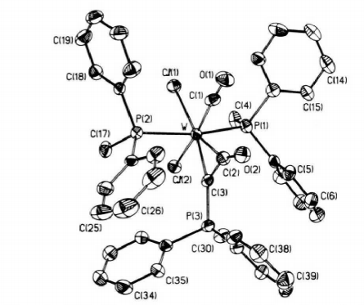
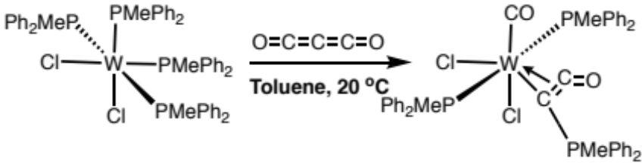
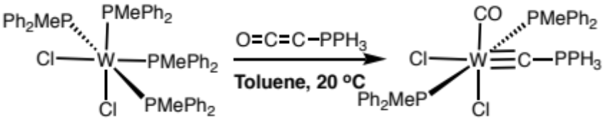
Early Career
Reactivity of W(0)/Re(0) with carbon suboxide
J. Am. Chem. Soc. 1985, 107, 7772
C–C bond cleavage of carbon suboxide
J. Am. Chem. Soc. 1988, 110, 4855
Organometallics, 1989, 8, 2015

Slide 7
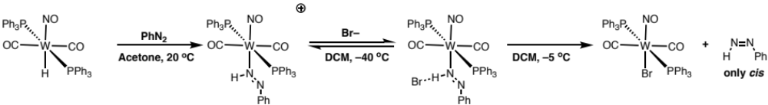
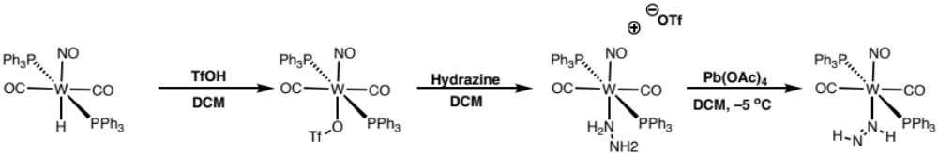
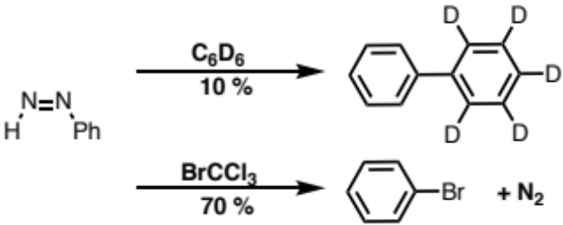
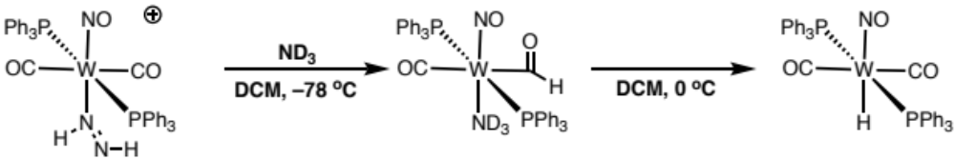
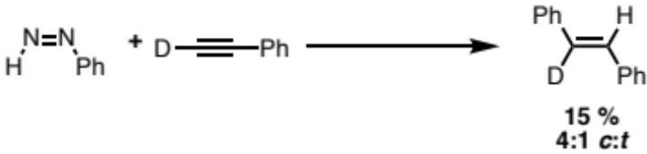
Synthesis and Reactivity of Diazenes
First synthesis of cis-diazene
J. Am. Chem. Soc., 1988110, 4067
First synthesis of metal diazene complex
J. Am. Chem. Soc., 1993, 115, 8638
Radical addition of Ph radicals
Attempt to Capture free diazene
J. Am. Chem. Soc., 1994, 116, 204
J. Am. Chem. Soc. 1989, 111, 3765

Slide 8
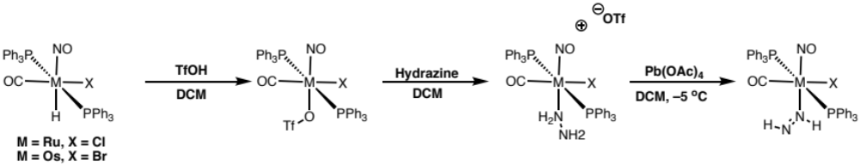
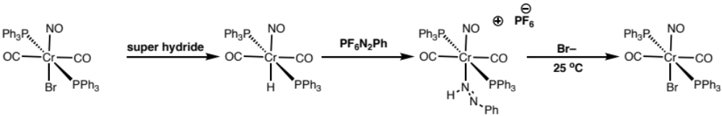
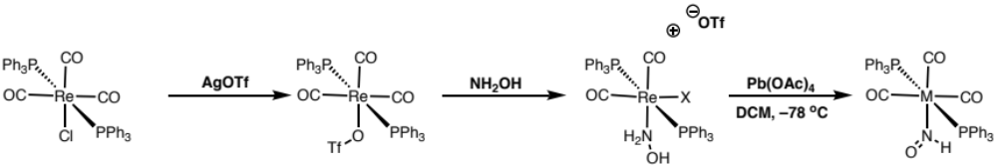
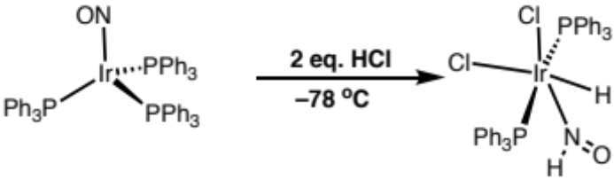
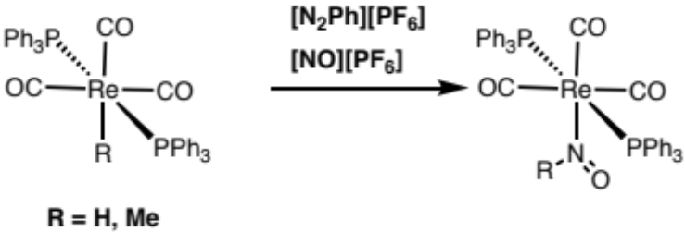
More Diazenes and Analogs
Ru and Os Diazene complexes
Angew. Chem., Int. Ed. Engl. 1994, 33, 657
Less reactive Cr diazenes
NHO complexes
Polyhedron, 1994, 11, 1741
Chem. Commun., 2002, 660
J. Am. Chem. Soc., 1997, 119, 12406
J. Am. Chem. Soc., 2002, 124,12068

Slide 9


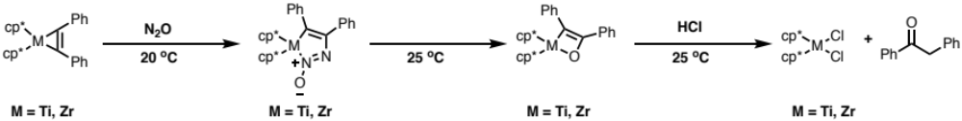
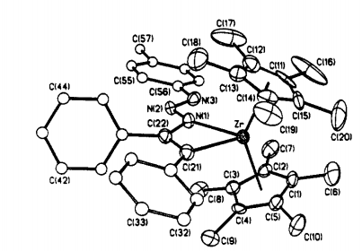
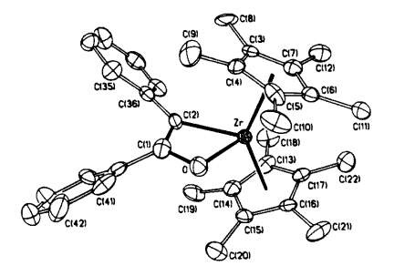
Reactivity of N₂O
Reactivity of d⁰ metals with N₂O
J. Am. Chem. Soc.,1989, Ill , 5491
J. Am. Chem. Soc. 1987, 109, 5538

Slide 10
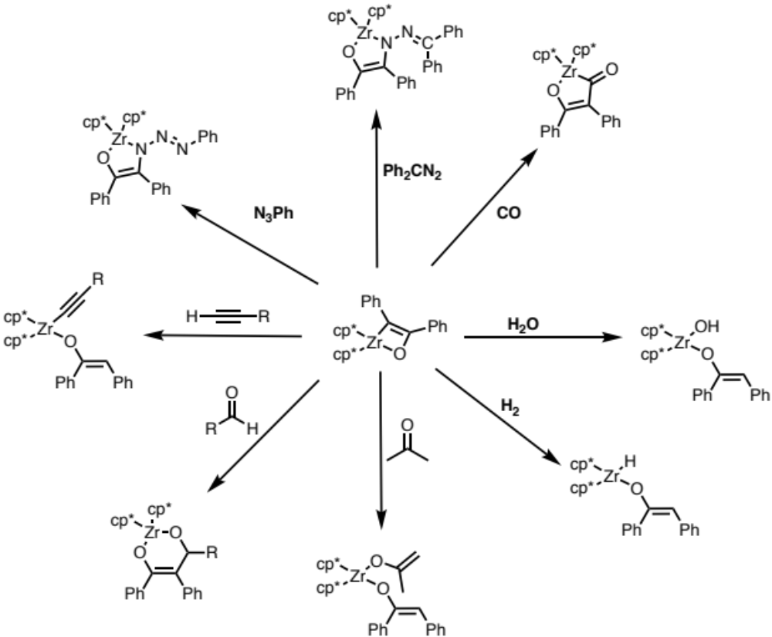
Diversification of Products
J. Am. Chem. Soc., 1990, 112, 7998

Slide 11
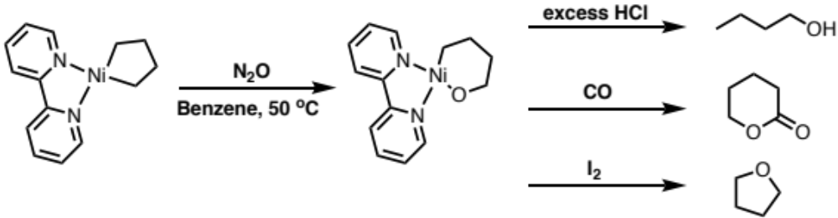
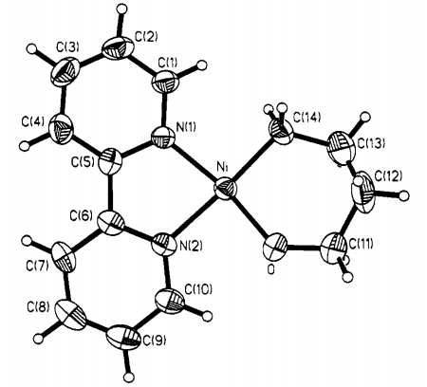
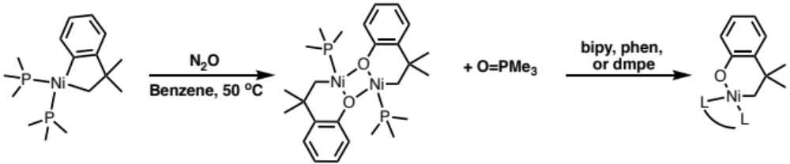
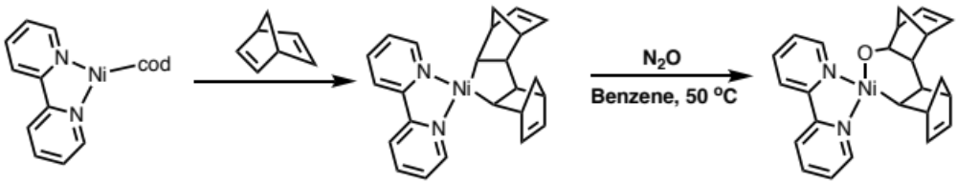
Reactivity of Nickel with N₂O
Reactivity of Ni(II) with N₂O
J. Am. Chem. Soc., 1993, 115, 2075
Organometallics, 1995, 14, 456
[2+2+1] cyclization with alkenes and N₂O
Polyhedron,1995, 14,175

Slide 12
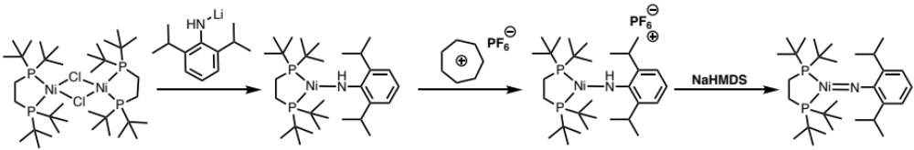
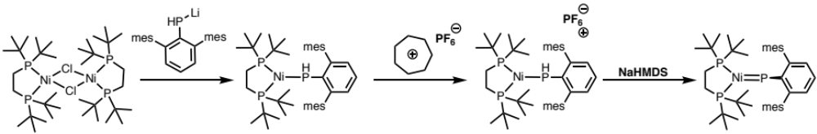
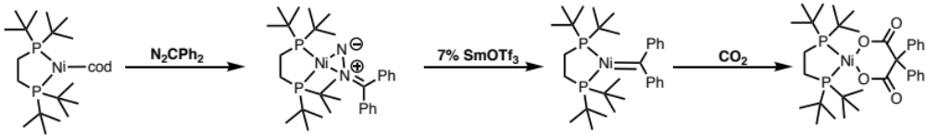
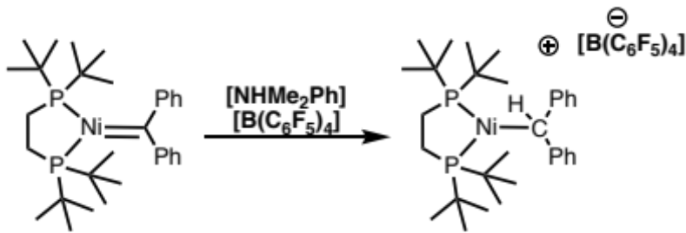
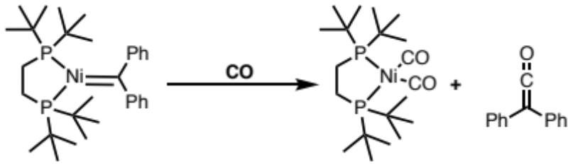
Synthesis of 3-Coordinate Nickel(II)
J. Am. Chem. Soc. 2001, 123, 4623
J. Am. Chem. Soc. 2002, 124, 3846
J. Am. Chem. Soc. 2002, 124, 9976

Slide 13
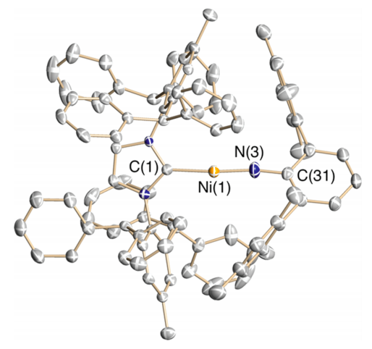
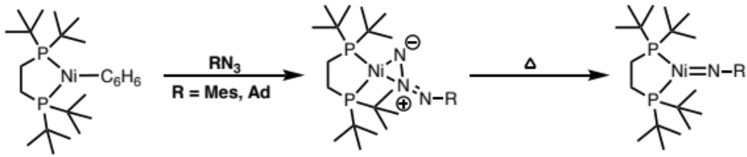
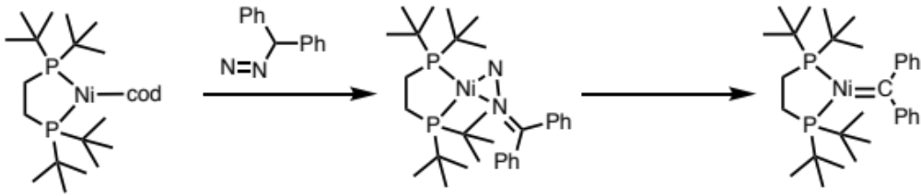
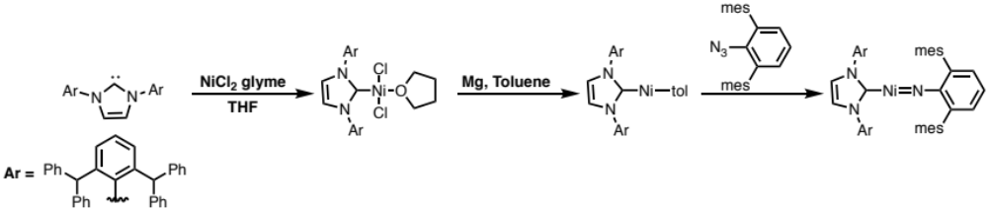
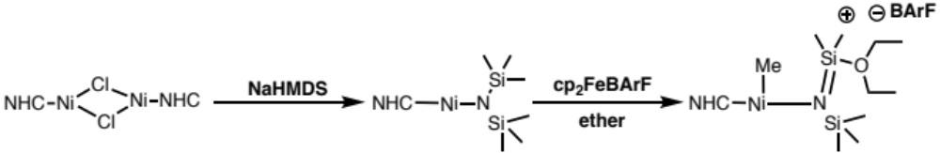
Second Generation Synthesis
One Step!
J. Am. Chem. Soc. 2008, 130, 12628
Chem. Sci., 2011, 2, 321
2 Coordinate Ni(II)
J. Am. Chem. Soc. 2011, 133, 771
Cationic Ni(II)
J. Am. Chem. Soc. 2008, 130, 13846

Slide 14
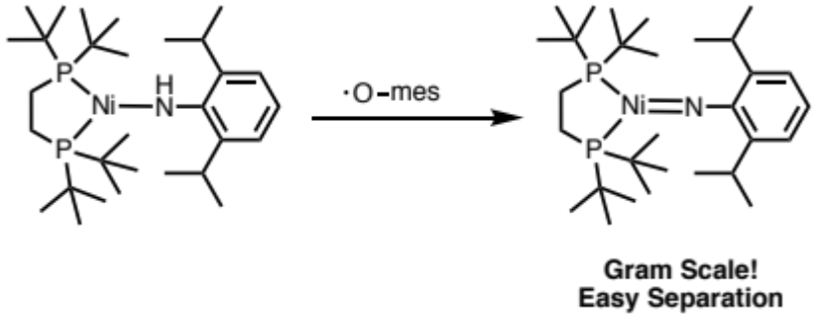
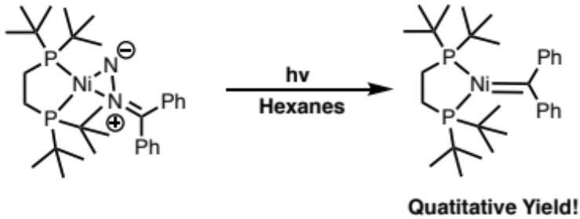
Third Gen Synthesis
Waterman, R. Ph.D. Thesis. The University of Chicago, 2004.
Inorg. Chem. 2014, 53, 13227
J. Am. Chem. Soc. 2014, 136, 6479

Slide 15
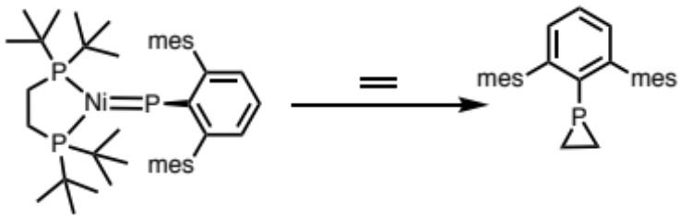
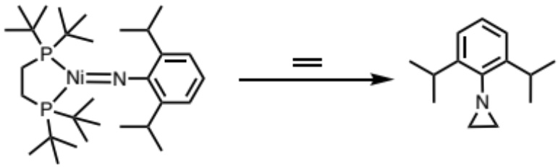
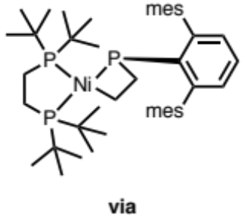
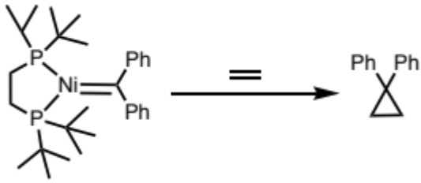
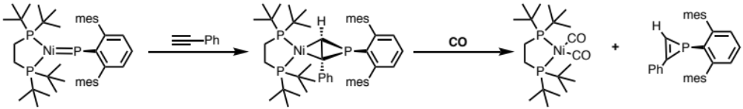
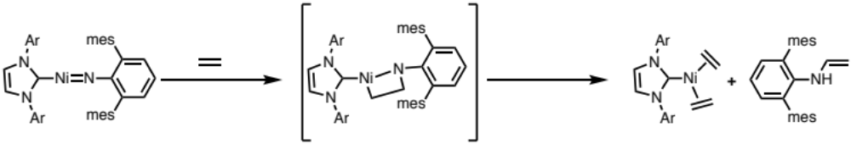
Group Transfer of Ni(II)
Addition to Alkenes
J. Am. Chem. Soc. 2003, 125, 13350
Addition to Alkynes
Nitrene Transfer
Organometallics 2003, 22, 5182
J. Am. Chem. Soc. 2011, 133, 771
J. Am. Chem. Soc. 2009, 131, 12872

Slide 16
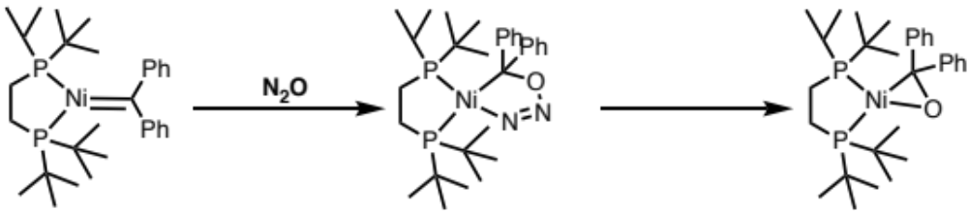
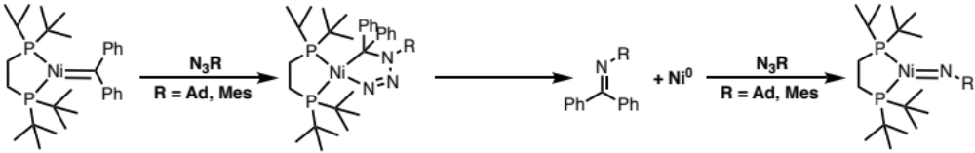

Reactive Nitrogen Species
Reaction with N₂O
A Catalytic Reaction to Come
J. Am. Chem. Soc. 2009, 131, 12872
First Metal Oxidative Addition to Aziridine
J. Am. Chem. Soc. 2002,124, 2890

Slide 17


A Catalytic Reaction
Chem. Sci., 2011, 2, 321
Organometallics 2009, 28, 6114

Slide 18




Synthesis of Ni(I) Complexes
Synthesis of Ni(I) alkyl species
Synthesis of NHC Ni(I) alkyl species
J. Am. Chem. Soc. 2004, 126, 10554
J. Am. Chem. Soc. 2013, 135, 18272

Slide 19



Reactivity of Ni(I) Complexes
Reactivity of Neopentyl Ni(II) Species
Radical Oxidative Addition to Ni(I) Alkyls
Organometallics 2009, 28, 2568
J. Am. Chem. Soc. 2013, 135, 18272

Slide 20


Nickel (III) Complexes
J. Am. Chem. Soc. 2011, 133, 13055

Slide 21


Thank You!

