Slide 1
Transition Metal Catalyzed Olefin Polymerization via Coordination-Insertion Mechanism
Yang Gao
Engle Lab
13 September 2018

Slide 2
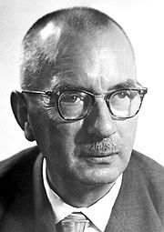
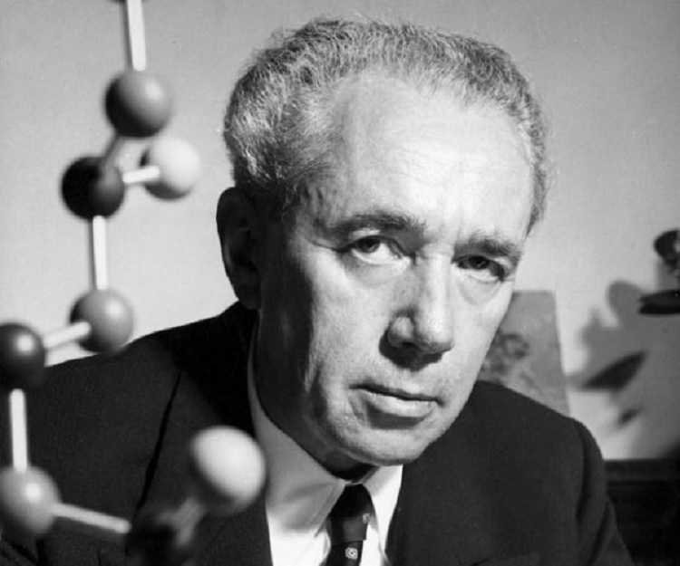
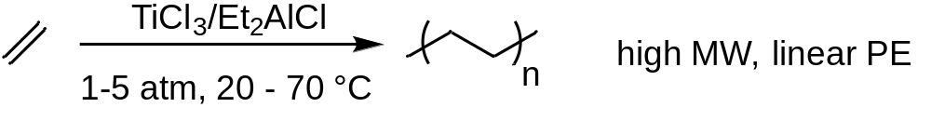
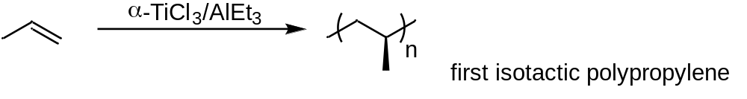
Ziegler-Natta Catalyst
Named after Karl Ziegler and Giulio Natta
Used to polymerize terminal alkenes
Winners of the Nobel Prize (1963)
Natta, G. et. al J. Am. Chem. Soc. 1955, 77, 1708.
Notes:
Ziegler-Natta catalyst was named after Dr. Ziegler and Dr. Natta. Both of them won the Nobel Prize in 1963. Karl discovered the first-titanium-based catalyst for ethylene polymerization, using TiCl3 and diethylalluminum chloride as cocatalyst.

Slide 3
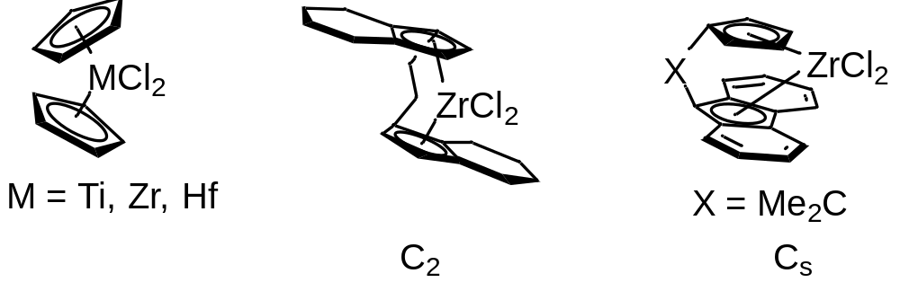
Ziegler-Natta Catalyst
Heterogeneous catalysts
TiCl₄ or TiCl₃ supported on MgCl₂ in presence of AlEt₃ or AlEt₂Cl
Homogeneous metallocene catalysts
Non-metallocene catalysts
Application of methylaluminoxane (MAO) enhanced the activity by a factor of 10000
Notes:
Since the first discovery of heterogeneous ZN catalyst, it has been rapidly developed and used in industry, to catalyze homopolymerization of ethylene and copolymerization of ethylene with 1-alkene. Another group of catalyst is used for isotactic polyolefin synthesis.

Slide 4
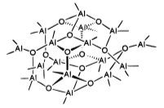
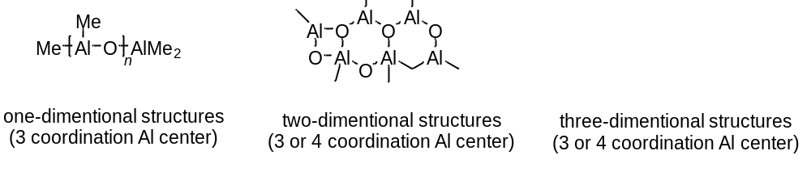
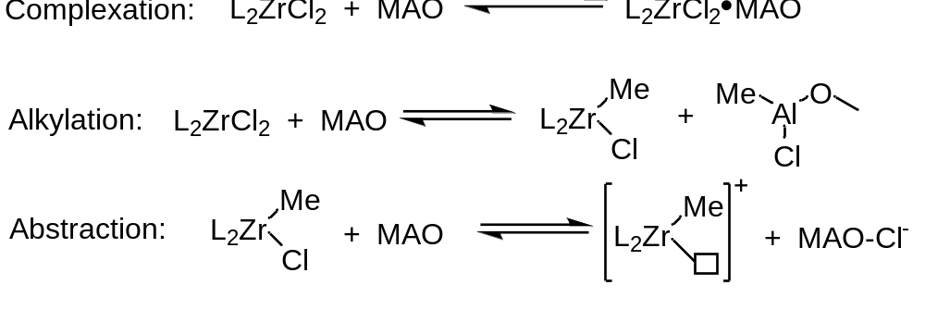
MAO Activators
Examples of proposed MAO structures:
Activation Mechanism:
Large excess of MAO to Zr (10² to 10⁴ : 1) is needed.
Marks, T. et. al. Chem. Rev. 2000, 100, 1391
Notes:
Methylaluminoxane is prepared by controlled hydrolysis of AlMe3. Although very exntensive research has been carried out, the exact composition and structure of MAO are still not entirely clear. The proposed MAO strcutres include
It is generally assumed that some of the Al centers in MAO have an exceptionally high propensity to abstract a Cl- or Me- and form ion-paired structure

Slide 5
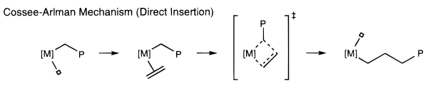
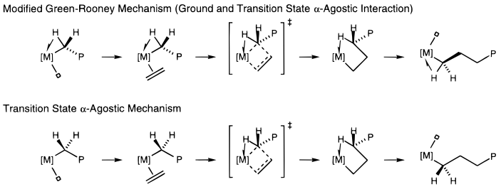
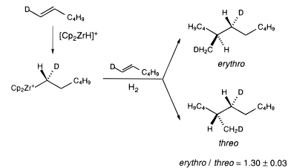
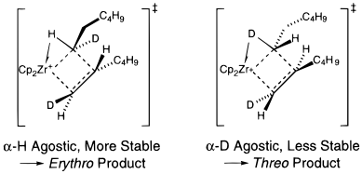
Mechanism of Ziegler-Natta Polymerization
Evidence of α-agnostic interaction:
Grubbs, R. H. Acc. Chem. Res. 1996, 29, 85
Brintzinger, H. H. Angew. Chem. Int. Ed. Engl. 1990, 102, 1412
Notes:
The basic mechanistic steps of this ZN polymerization include olefin coordination and followed by olefin insertion into M-C bond. Different proposals for the nature of this insertion were proposed.
The first is alkyl migration to the coordinated olefin
The second proposed by Green, Rooney and Brookhart where a hydrogen atom at a-carbon of the growing polymer chain interacts with the metal center throughout the catalytic cycle.
The third is the hybrid version of the first two mechanism where a-hydrogen interaction only happens during the transition state of C-C bond forming step.
Hydrodimerization of deuterated 1-hexene

Slide 6
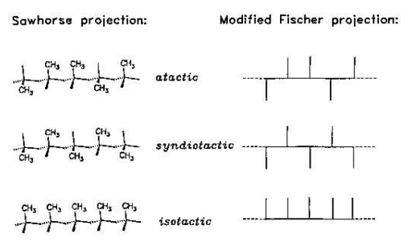
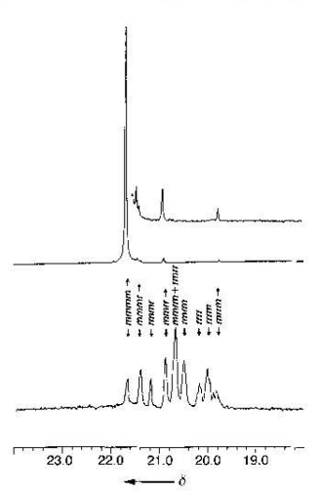
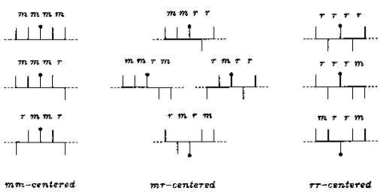

Stereochemistry of poly-1-alkenes
¹³C NMR (Me region)
Isotactic PP
([mmmm] > 90%)
$$[mmmm]=\frac{int(mmmm)}{SUM [int\left(pentad\right)]}$$
m (meso), r (racemo)
atactic PP
The ¹³C shift of CH₃ is determined by the configurations of two neighboring units
Brintzinger, H-H. Angew. Chem. Int. Ed. Engl. 1995, 34, 1143
Notes:
13C NMR spectroscopic methods were used to characterize the stereoregularity of poly(a-olefins).
Relative configurations of neighboring units are designated as meso for equally and raceme for unequally positioned substituents in a Fisher-type projection of polymer chain. Each Me signal is thus assignable to a particular “pentad” pattern, represented by the four consecutive m or r.
The degree of isotacticity of such a polymer is usually expressed as the ratio of the mmmm pentad integral to the intergral sum of all pentad signals observed

Slide 7
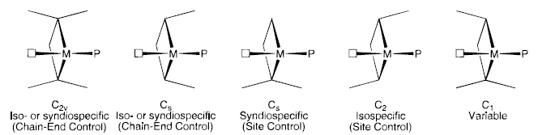
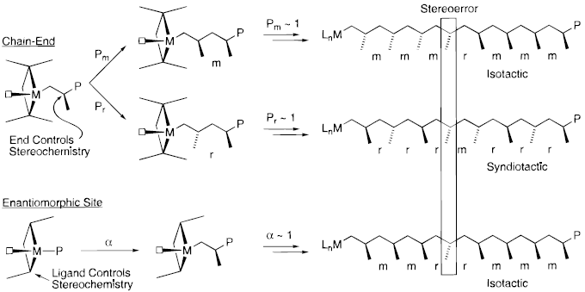

Stereochemical Control
General symmetry classification:
[mmmr]:[mmrm] = 1:1
[mmmr]:[mmrm]:[mrrm] = 2:2:1
Coates, G. W. Chem. Rev. 2000, 100, 1223
Notes:
Single site polymerization catalysts can be divided into 5 main symmetry categories. It is assumed that the polymer rapidly equilibrates with the available coordination site for the purpose of assigning symmetry. Catalsyt wit c2v symmetry generally form atactic polymer or moderately stereoregular polymers by chain-end control.
CS symmetry that has mirror planes containing two diastereotopic coordination sites behave similarly.
CS symmetry that has mirror reflect two enantiotopic coordination sites produce syndiotactic polymer
C2 symmetryproduce isotactic polymer
When a stereoerror happens

Slide 8
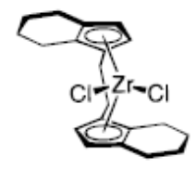
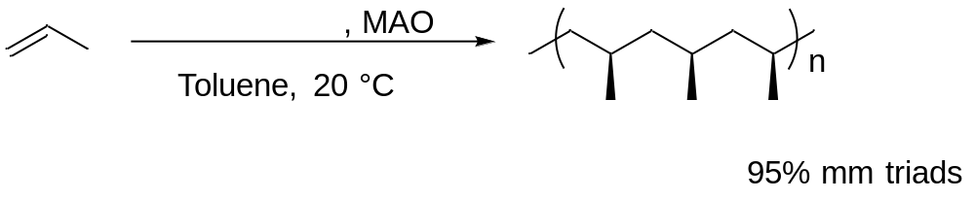

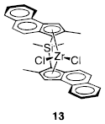
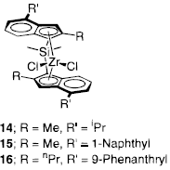
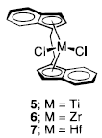
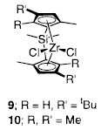
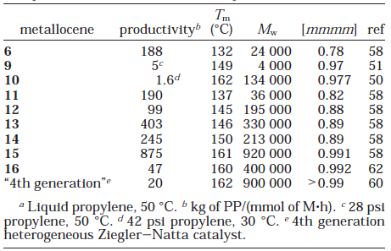
C₂-Symmetric Catalysts for Isotactic Polymers
Brintzinger, H-H. Angew. Chem. Int. Ed. Engl. 1985, 24, 507
The most successful catalysts are those with rigid C₂-symmetric chelating ligands with a bridging group.
Coates, G. W. Chem. Rev. 2000, 100, 1223
Notes:
By using an tetrahydroindenyl zirconocene to produce only isotactic poly chains.
Principally, the catalyst can be
varied in three ways: (1) modification of the bridge;
(2) modification of the è5-ligand; (3) variation of the
activator

Slide 9
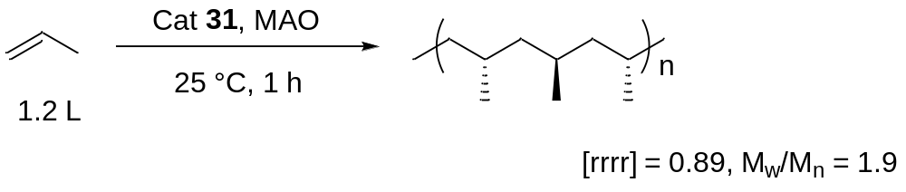
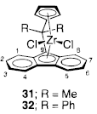
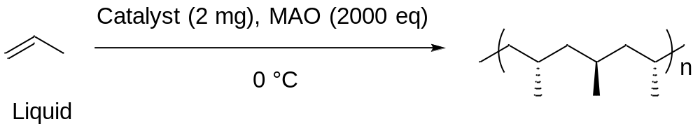
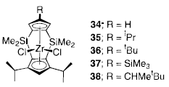
Syndiotactic-PP Synthesis
Ewen, O., J. Am. Chem. Soc. 1988, 110, 6255.
entry | catalyst | activity | [rrrr] | [mmmm]
1 | 34 | 2160 | 83.7 | 0.0
2 | 35 | 1750 | 98.9 | 0.0
3 | 36 | 1730 | 95.9 | 0.0
4 | 37 | 722 | 90.5 | 0.0
5 | 38 | 930 | 41.8 | 5.6
Bercaw, J. E. J. Am. Chem. Soc, 1996, 118, 11988
Notes:
Ewen reported that catalyst 31 is highly active for the syndiospecific polymerization of propylene and other aliphatic a-olefins
Bercaw has designed novel CS-symmetry doubly bridged zirconocenes for the synthesis of syndiotactic polymers

Slide 10
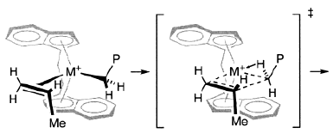
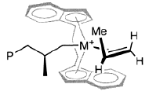
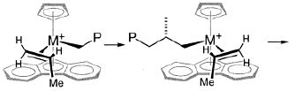
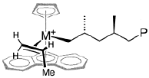
Mechanism for Ligand Controlled Polymerization
C₂-symmetric catalyst isotactic
Homotopic reaction site, α-agostic interaction enhanced selectivity
C_{s}-symmetric catalyst syndiotactic
Enantiotopic reaction site
Coates, G. W. Chem. Rev. 2000, 100, 1223

Slide 11
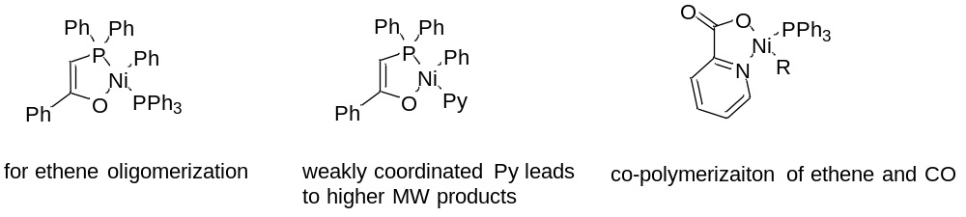
Early Development of Late-TM Catalyzed Polymerization
SHOP-type catalysts (SHOP = Shell Higher Olefin Process)
Evaluation of Late-metal system:
Facile ability to undergo β-hydride elimination
Low activity towards olefin insertion because of the rich-electron d orbitals
Good functional group tolerance
Ligand design
Electrophilicity tuning
Notes:
The high oxophilicity of early transition metal catalyst causes them to be poisoned by most functionalized olefins, particularly the commercially available polar comonomers

Slide 12
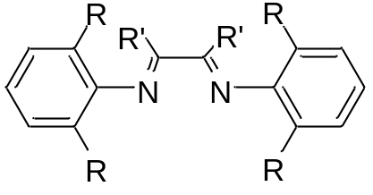
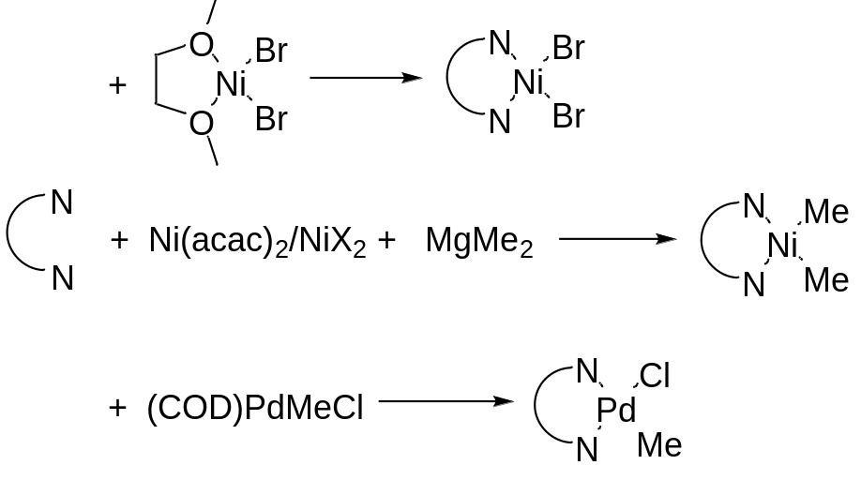
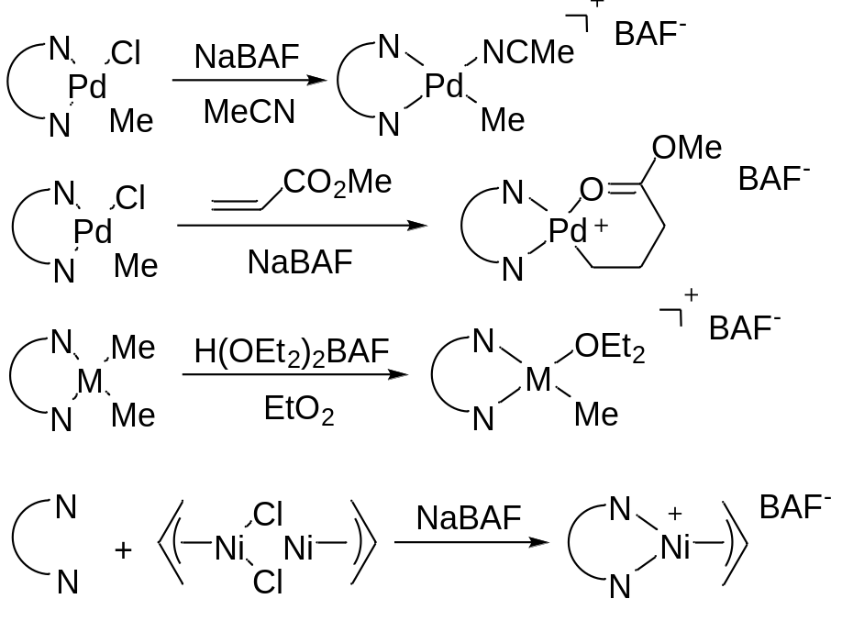
α-Diimine System
The electrophilic and cationic metal centers
Sterically bulky bidentate ligands
Bulky non-coordinating counterions
Ligand displacement methods:
Cationic complexes synthesis:
Brookhart, M. Chem. Rev. 2000, 100, 1169
Notes:
NaBArF is used to abstract the chloride ligand, while the metal complex is tpically stabilized by relatively weak donor ligands such as acetonitrile. A more successful route to cationic palladium and nickel ether adduct is through protonation of the dimethyl complex in the presence of diethyl ether. The ether ligand is very labile, making it ideal for the low t NMR mechanistic studies

Slide 13
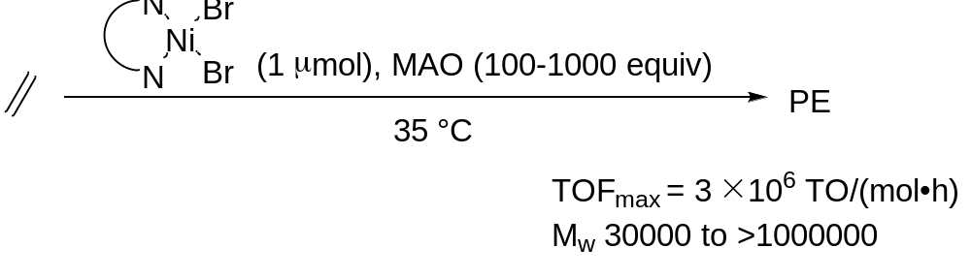
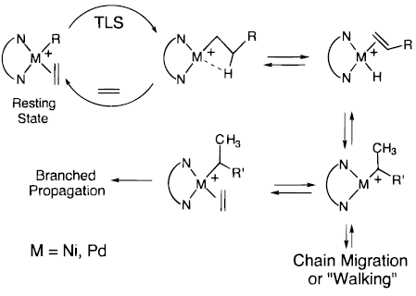
α-Diimine Mediated Ethylene Polymerization
Pd catalyst
Highly branched PE without the intermediacy of α-olefin
Useful as base stocks or additives for lubricants
Turnover-limiting step: migration insertion
Barrier (insertion) in the Ni complex is ca. 4-5 kcal/mol lower than the Pd complex.
Increased steric bulk of ligand promotes insertion reaction.
Brookhart, M. Chem. Rev. 2000, 100, 1169
Notes:
The resulting PE microstructures can be varied from strictly linear to highly branched. However, under a given set of conditions, polymers derived from their palladium analogues are more branched. Based on NMR spectroscopy, the alkyl ethylene complex was found to be resting state.
Migratory Insertion barrier in the palladium system lie in the range of 17-18 kcal/mol, 13-14 kcal/mol for ni
Beta-agostic interaction lead to chain walking.
the steric bulk in the axial sites of the square plane of these R-diimine complexes is a critical requirement for retarding the chain transfer

Slide 14
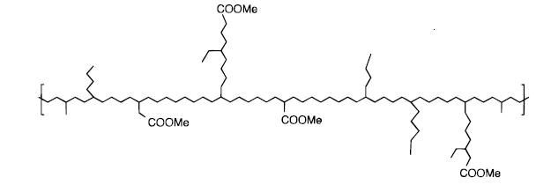
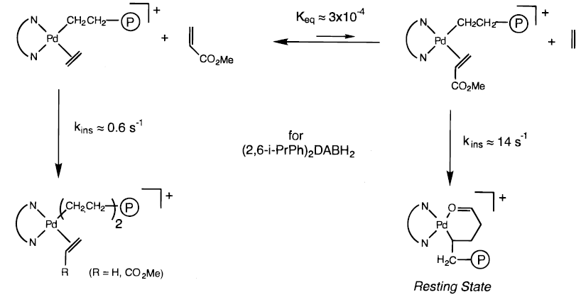
Ethylene/Methyl Acrylate(E/MA) Copolymerization
Brookhart, M. Chem. Rev. 2000, 100, 1169
amorphous, highly branched, ester groups located at the end of branches mostly
Large MA/E ratio needed
Other successful examples: methyl vinyl ketones and sillyl vinyl ethers
Failed case: vinyl acetate, acrylonitrile and vinyl chloride
Notes:
The strong binding of o to the pd center in the chelate rs retards the rate of chain growth relative to the rate of ethylene homopolymerization

Slide 15
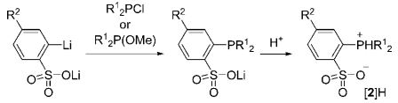
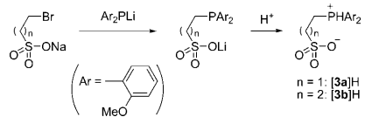
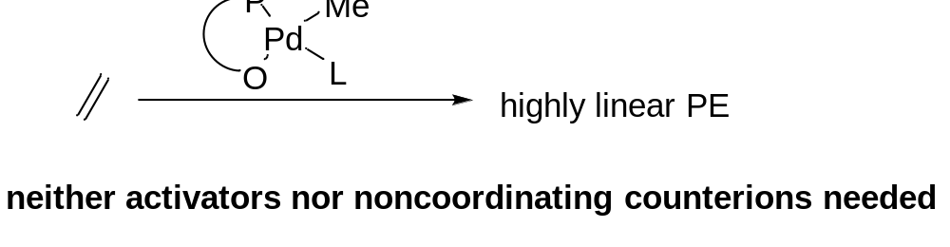
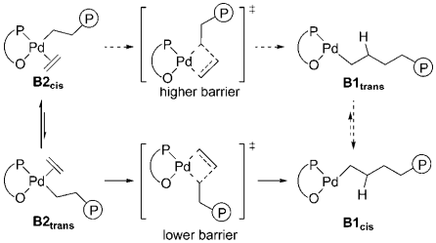
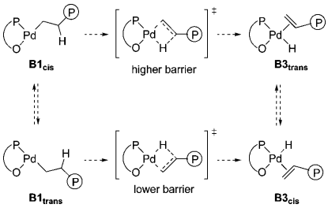
Phosphine-Sulfonate
Ligand synthesis:
Ethylene Polymerization:
Bulky substituents on the phosphorus atom helps!
Ethylene insertion:
β-H elimination (suppressed with high [C₂H_{4]}:
Nozaki, K. Chem. Rev. 2009, 109, 5215
Notes:
Pd complex bearing a phosphine-sulfonate ligand play an important role in the polymerization of polar vinyl monomers. A family of phosphinoarylsulfonate ligands has been synthesized by the reaction of ortho-lithiated benzenesulfonate derivatives with diorganophosphine chloride or diorganophoshine methoxide.
Diaryl phosphide react with bromoalkylsulfonate

Slide 16
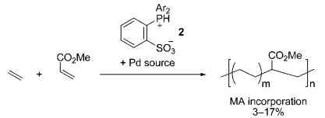
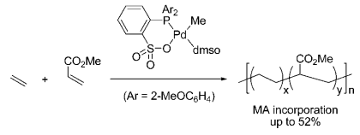
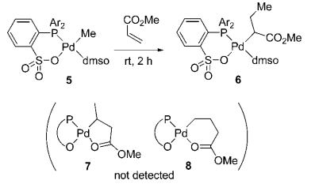
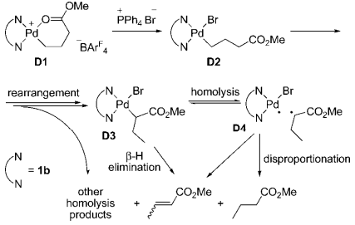
E/MA Copolymerization by the Pd P-S System
Notes:
This can be attributed to the fact that the neutral palladium complexes prefer to have an ester group at the R-position
while cationic complexes prefer the γ-position due to formation of an intramolecular chelate structure

Slide 17
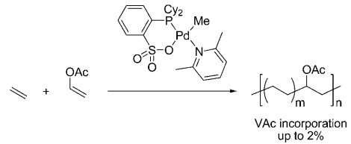





E/PVM Copolymerization with P-S System
Nozaki, K. J. Am. Chem. Soc. 2009, 131, 14606
Nozaki, K. J. Am. Chem. Soc. 2007, 129, 8948
Jordan, R. F. J. Am. Chem. Soc. 2007, 129, 15450
Jordan, R. F. J. Am. Chem. Soc. 2007, 129, 8946
R¹ = Me
R² = NMe₂
R³ = 2,4-(MeO)₂C₆H₃
Carrow, B. P. J. Am. Chem. Soc. 2018, 140, 8841
Notes:
Vinyl acetate 80C, highly linear PE backbones without detectable branching unit
AcrylonitrileAN units found in the polyethylene backbone as well as initiating and terminating chain ends.
Vinyl fluoride, less likely to radical polymerization and beta-elimination. Low level of incorporation may be attributed to the weak coordination
Vinyl ether
Phosphonic amide

Slide 18








A New Family of E/PVM Copolymerization Catalysts
Bisphosphine Monoxide Pd Complexes
Nozaki, K. J. Am. Chem. Soc. 2012, 134, 8802
Notes:
Cationic bisphosphine monoxide-Pd complex

Slide 19
Thank you

